Slide 1


LF01 - GROUP 8
2602055281 - Angel Priscilla Salim
2602169371 - Madeline Andrea Sofian
ANOMALY DETECTION: UNUSUAL ACTIVITIES IN NETWORK TRAFFIC
COMP6140001 - Data Mining

Slide 2
THE URGENCY
The Cost for Businesses
Operational disruption : Disruption of day to day business activities, server/service downtime due to the attack
Financial loss : Theft of financial data, Lost of revenue
Reputational damages : Erode customers’ trust and loyalty
Increasingly sophisticated technological threats through the rise of greater internet/network usage posing a greater challenge to traditional network monitoring system.

Slide 3

BENEFITS OF EARLY DETECTION
Faster detection & handling of unusual network activities
Prevent prior attacks from escalating to more serious network breaches
Prevent greater financial, operational* and reputational damage
*Studies show that early detection of anomalies can reduce operational downtime by up to 50% and save businesses millions annually in lost revenue and repair costs.

Slide 4
THE OBJECTIVES
DATA MINING
BUSINESS
Garner insights on the attributes that are linked to unusual network activities to support early attack detection in network activities
Aid busineses in enhancing their Network Security system while protecting critical assets
Optimize operational cost in network monitoring
Bolstering security and trust among stakeholders

Slide 5
DATASETS & EDA

Slide 6
Dataset A
UNSW-NB15
Dataset B
Malware Detection in Network Traffic Data
An academic dataset comprising a hybrid of the real modern normal and the contemporary synthesized attack activities of the network traffic
The dataset of an IoT network traffic labeled malicious and benign are captured ranging from 2018 to 2019

Slide 7
Dataset A
Dataset B
700 001 entries
49 Attributes
6 String
43 Numerical
1 008 748 entries
23 Attributes
15 String
8 Numerical

Slide 8
Dataset A
srcip
sport
dstip
dsport
proto
state
dur
sbytes
dbytes
sttl
dttl
sloss
dloss
service
Sload
Dload
Spkts
Dpkts
swin
dwin
stcpb
dtcpb
smeansz
dmeansz
trans_depth
res_bdy_len
Sjit
Djit
Stime
Ltime
Sintpkt
Dintpkt
tcprtt
synack
ackdat
is_sm_ips_ports
ct_state_ttl
ct_flw_http_mthd
if_ftp_login
ct_ftp_cmd
ct_srv_src
ct_srv_dst
ct_dst_ltm
ct_src_ltm
ct_src_dport_ltm
ct_dst_sport_ltm
ct_dst_src_ltm
attack_cat
Label

Slide 9
Dataset B
ts
uid
id.orig_h
id.orig_p
id.resp_h
id.resp_p
proto
service
duration
orig_bytes
resp_bytes
conn_state
local_orig
local_resp
missed_bytes
history
orig_pkts
orig_ip_bytes
resp_pkts
resp_ip_bytes
tunnel_parents
label
detailed-label

Slide 10
Dataset A
Dataset B
Merged Dataset
srcip
sport
dstip
dsport
proto
state
dur
sbytes
dbytes
service
Spkts
Dpkts
Stime
Label
ID
id.orig_h
id.orig_p
id.resp_h
id.resp_p
proto
conn_state
duration
orig_bytes
resp_bytes
service
orig_pkts
resp_pkts
ts
label
uid
SourceIP
SourcePort
DestinationIP
DestinationPort
Protocol
State
Duration
BytesSent
BytesDestination
Service
PacketsSent
PacketsReceived
TimeStamp
Label
ID
15 Common Attributes

Slide 11
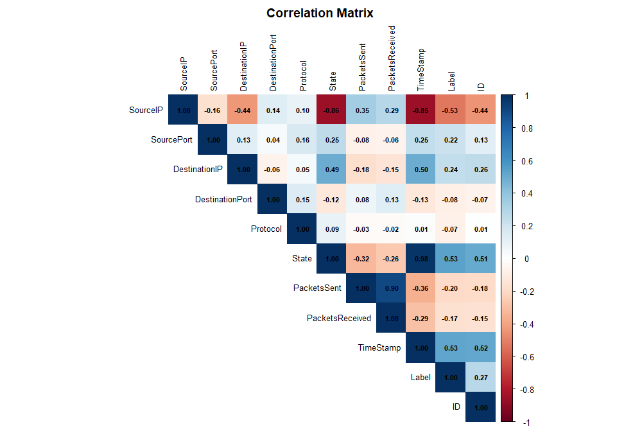
Highlights the factors that influence whether the network activity is normal (benign) or unusual (malicious).
Strong correlations are identified based on larger nominal values and darker colours
(+) : Directly related to the Malicious Label
(-) : Inversely related to the Malicious Label
Notable factors:
Source IP, State (of connection) and Time Stamp have a strong correlation with the types of Label given
Source Port, Destination IP, (Amount of ) Packets Sent have a weaker correlation to the Label
The Correlation Map

Slide 12
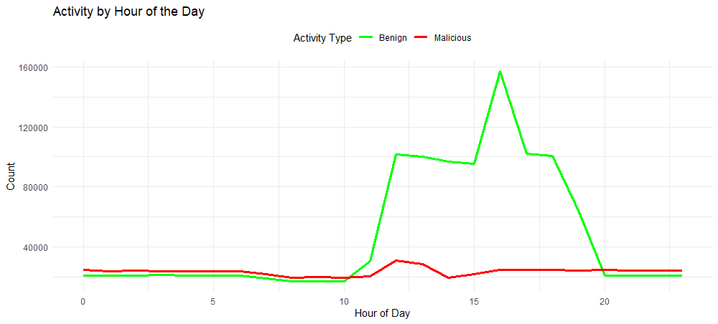
Relationship between TimeStamp and Malicious Activities
Presents the general network activity on an hourly basis in a span of 24 hours.
Based on the plot, the number of unusual activities/attack usually rise during the noon at about 12 to 1 pm from about 10000 to about 20000 counts.

Slide 13
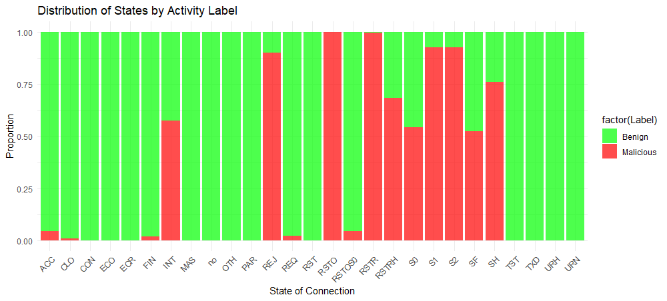
Relationship between State and Malicious Activities
Presents the distribution of connection states of protocols and their relation with unusual activities/attack.
Based on the plot, unusual activities/attack usually occur during the INT, REJ, RSTD, RSTR, RSTRH, S0, S1, S2, SF, SH connection state.

Slide 14
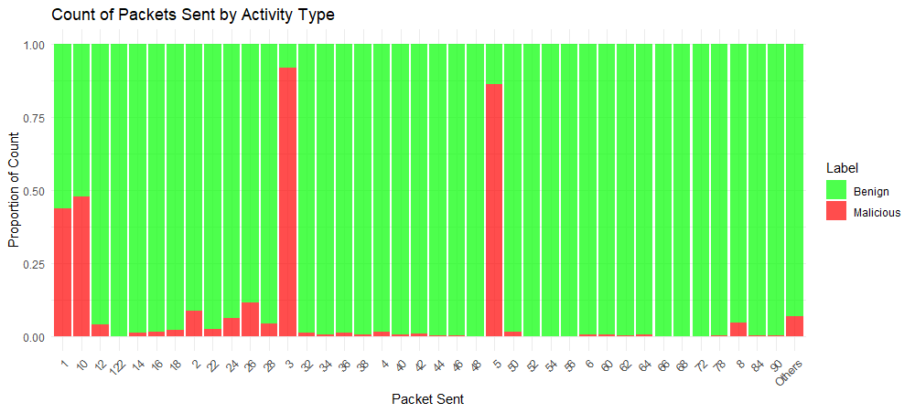
Common number of Packets Sent as Malicious Activities
Presents the proportion of Length of Packets Sent from the Source to the Destination.
Based on the plot, unusual activities/attack generally send packets with length 1, 3, 5 and 10.

Slide 15
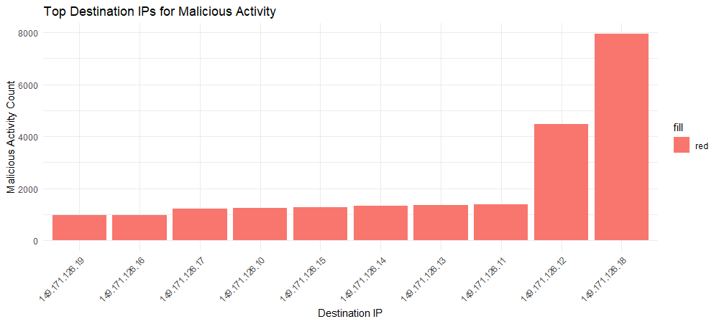
Top Destination IPs conducted for Malicious Activities
Presents the frequent Destination IPs targeted to conduct unusual activities/attacks.
Based on the plot, unusual activities/attack are mostly targeting Destination IP 149.171.126.18 and 149.171.126.12.

Slide 16
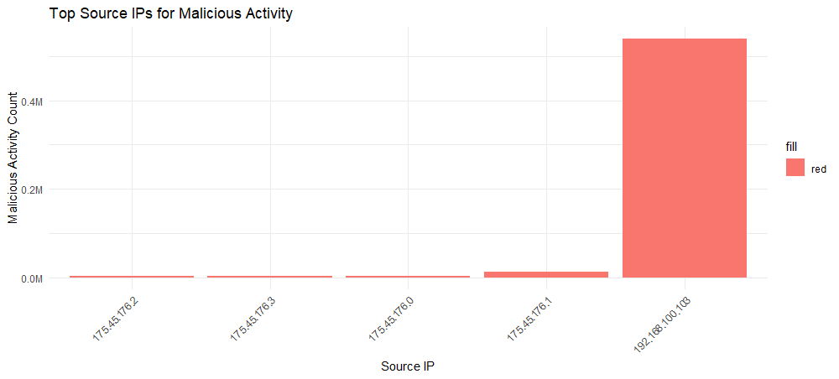
Top Source IPs used for Malicious Activities
Presents the frequent Source IPs used to conduct unusual activities/attacks.
Based on the plot, unusual activities/attack are mostly conducted by Source IP 192.168.100.103.

Slide 17
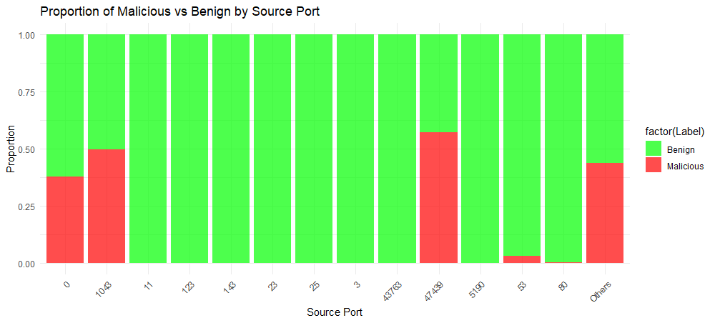
Top Source Port used for Malicious Activities
Presents the frequent Source Port used to conduct unusual activities/attacks.
Based on the plot, unusual activities/attack are mostly conducted by Source Port, 1043 and 47439.
*Source Port 0 is usually used in error states/malformed packets

Slide 18
DATA PREPARATION
1
Remove Duplicated Row
4
Handle Missing Value
Remove duplicated row in both datasets
Identify and remove the missing values in the merged dataset
2
Align Common Attributes
5
Feature Selection
Manually check for common attributes, and align the header & data type for each attributes in both dataset
Selecting correlated features based on correlation coefficient matrix with the threshold of |0.2|
3
Data Integration
Integrated the two dataset into one using rbind()

Slide 19
ISOLATION FOREST
How it works?
Why Isolation Forest?
Isolation Forest randomly splits data using decision tree. Anomalies are determined by the shortest paths to isolate
Works well with high-dimensional data (dataset with many features), because it isolates anomalies based on feature space partitions
High scalability and efficient, because the algorithm partitions the dataset using random splits
Detects global and local anomalies, because anomalies are isolated based on their path lengths in randomly built trees
Suitable for imbalanced data, because the algorithm focuses on isolating the most distinct points
What is calculated?
Isolation Forest calculates the path length or the average number of splits to isolate a data point, and its anomaly score.

Slide 20
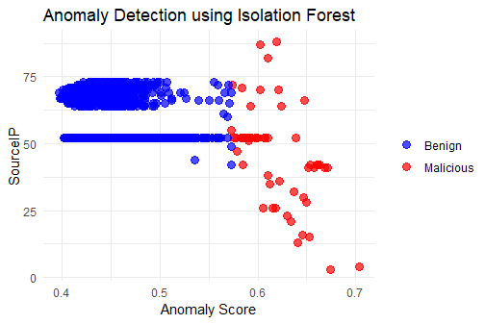
ISOLATION FOREST RESULT
MODEL ACCURACY :
68.33%
Imbalance Dataset
Inappropriate Threshold
Feature Selection Issue
Insufficient Training Data
Poor Hyperparameter Tuning

Slide 21
LOCAL OUTLIER FACTOR (LOF)
Why Local Outlier Factor (LOF)?
How it works?
Local Outlier Factor (LOF) compares the local density of a data point to the densities of its neighbors by assessing how isolated a point is.
Handles local variations by detecting outlier based on local densities, making it suitable for dataset with widely distributed data point
No assumption about data distribution, meaning that LOF can work effectively in situations where traditional statistical methods might fail
LOF reduce the impact of noise by using reachability distances and local densities
Versatility, LOF can handle datasets with multiple clusters, varying densities, and non-linear structure
What is calculated?
LOF calculates the distance to neighbors, reachability distance, local reachability density (LRD), and local outlier factor (LOF) to asses its isolation. A data point with higher LOF is likely an outlier.

Slide 22
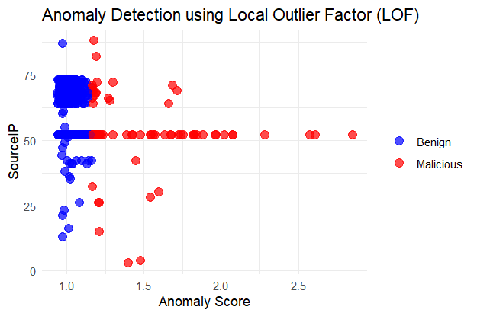
LOF RESULT
MODEL ACCURACY :
71.75%
Poor Quality of Data (excessive noise, imbalanced dataset)
Inappropriate Choice of k
High-Dimensional Data
Inappropriate Distance Metric
Presence of Similar Anomalies

Slide 23
XGBOOST
How it works?
Why XGBoost?
XGBoost builds a sequence of decision tree. Anomalies are determined by large residual errors
High Performance , great accuracy levels in detecting anomalies in complex datasets due to its gradient boosting framework
Handling Imbalanced Data, because of its ability to adjust weights and using evaluation metrics during training like logloss
Scalability, because of its efficient parallel processing & memory optimization making is suitable for large datasets with high dimensions.
Robustness, because of its built-in regularization (L1/L2) which reduces overfitting, ensuring reliable detection in noisy datasets.
What is calculated?
XGBoost calculates the all predictions from each trees with each tree’s contribution weighted to improve accuracy.

Slide 24
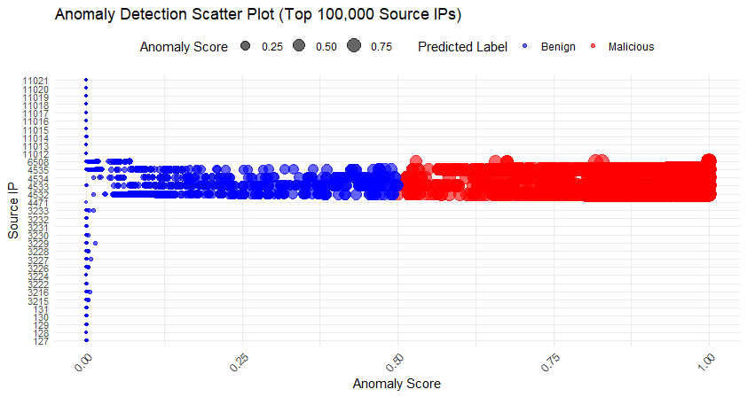
XGBOOST
MODEL ACCURACY :
99.92%
Supervised learning
Automatically identifies and rank the importance of features during training
Ables to model complex relationship using gradient boosting
Performs well in high-dimensional data
Robustness to noise

Slide 25
ACTIONABLE INSIGHTS
MAY BE MORE APPROPRIATE BUT NOT LIMITED TO
IT SECURITY TEAMS/NETWORK ADMINISTRATORS

Slide 26
Key Insights | Actionable insights
Unusual activities/attack rise during the noon (12-1 pm) | Implement stronger security measures and network monitoring during the business hours
2. Unusual activities/attacks occur during specific connection states (INT, REJ, RSTD, RSTR, RSTRH, S0, S1, S2, SF, SH) may indicate attack attempts such as scanning, SYN flooding, or connection hijacking | Monitor these states closely Implement intrusion detection mechanisms that flag unusual transitions or occurrences of these states
3. Unusual activities/attacks generally send packets with lengths of 1, 3, 5, and 10 may point to specific attack techniques such as small payloads used for scanning or exploitation. | Flagging these activities and further investigate for potential probing or low-and-slow attacks Establishing a baseline for normal packet length distribution to identify abnormal packet behavior

Slide 27
Key Insights | Actionable insights
4. Unusual activities/attacks are mostly conducted on Destination IPs 149.171.126.18 and 149.171.126.12 which indicated that they are specific servers/services of interest. | Tightening security around these IP addresses Monitoring for unusual traffic Isolating critical services for these IPs may mitigate the risks of targeted attacks
5. Unusual activities/attacks are mostly conducted by Source IP 192.168.100.103 | Investigate this IP address further for signs of compromise or misuse If it is an internal network, the system/service might be compromised and must be dealt with as soon as possible
6. Unusual activities/attacks are mostly conducted by Source Ports 1043, and 47439. | Monitor these ports for abnormal activities Implement firewalls or port filters to block or analyze traffic
7. XGBoost proven to be the best performing algorithm for detection of unusual network activities | Implement and integrate the XGBoost model to aid the team in detection of unusual network activities more efficiently.

Slide 28
THANK YOU !

